Slide 1
An Experimental Analysis of a Compact Graph Representation
Paper Review // 6.5060 Algorithm Engineering

Slide 2
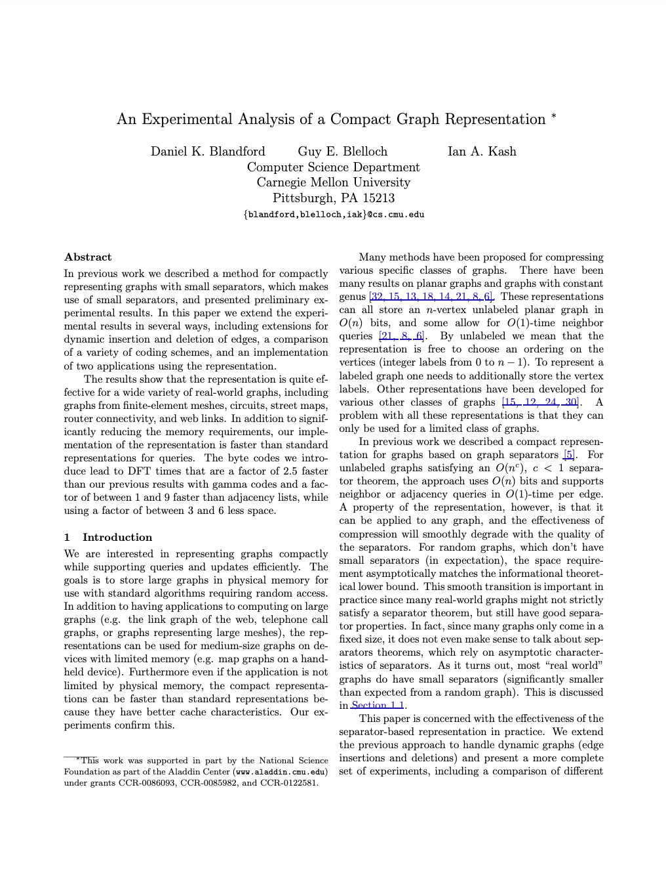




An Experimental Analysis of a Compact Graph Representation
Proceedings of the sixth Workshop on Algorithm Engineering and Experiments and the first Workshop on Analytic Algorithmics and Combinatorics (2004). Partially funded by the NSF, RIP.
Authors (CMU)
Dan(iel) K. Blandford
Guy E. Blelloch
Ian A. Kash
CMU
U Illinois
✅

Slide 3
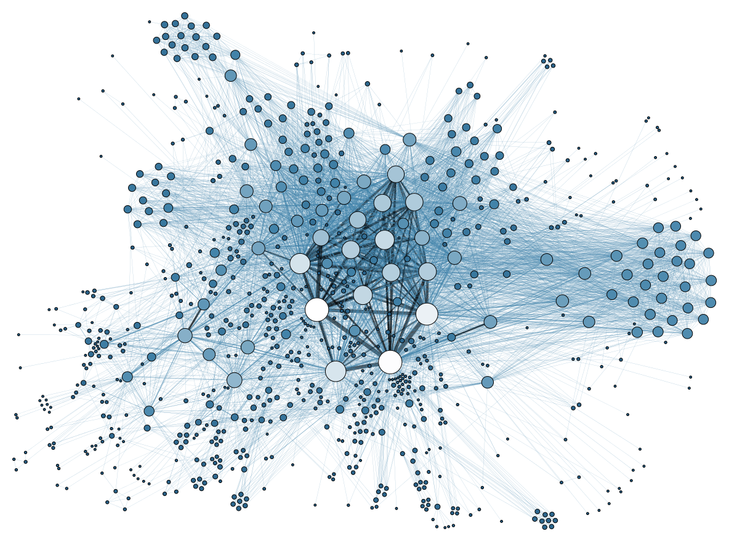
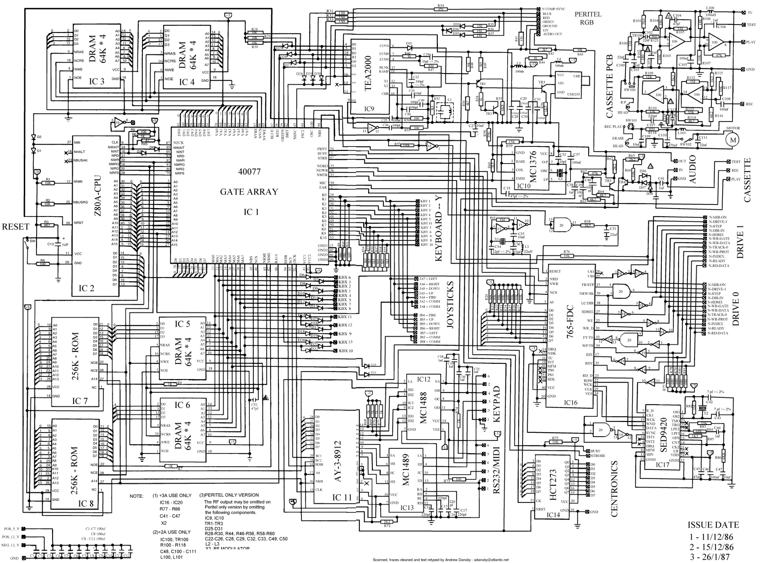

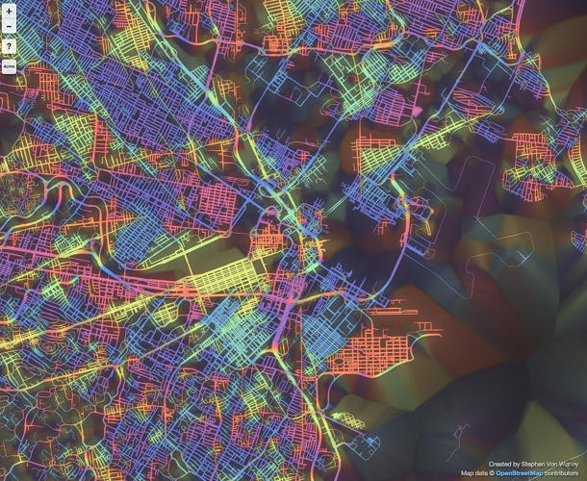
Large graph networks
https://geoawesome.com/cool-mapping-project-10-city-street-grids-visualized-by-orientation/

Slide 4
Large graph networks: What representation?

Slide 5
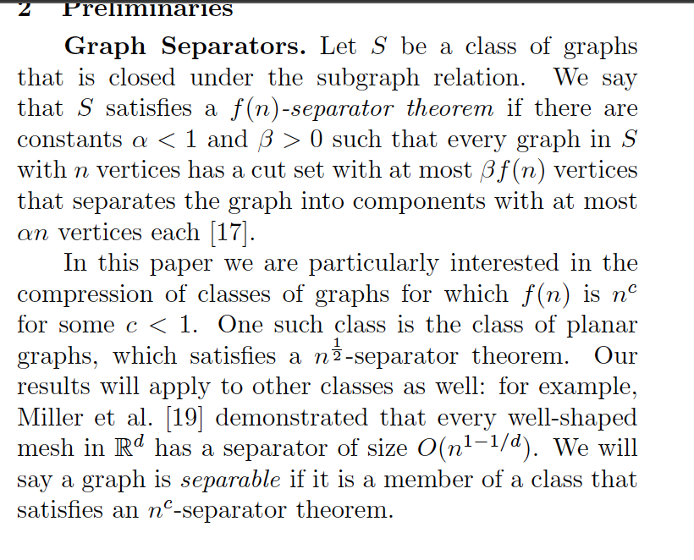
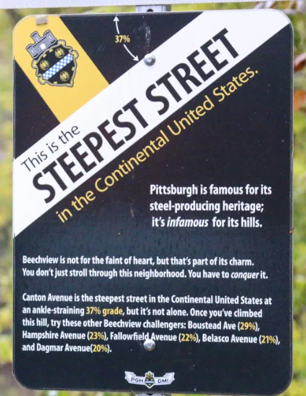
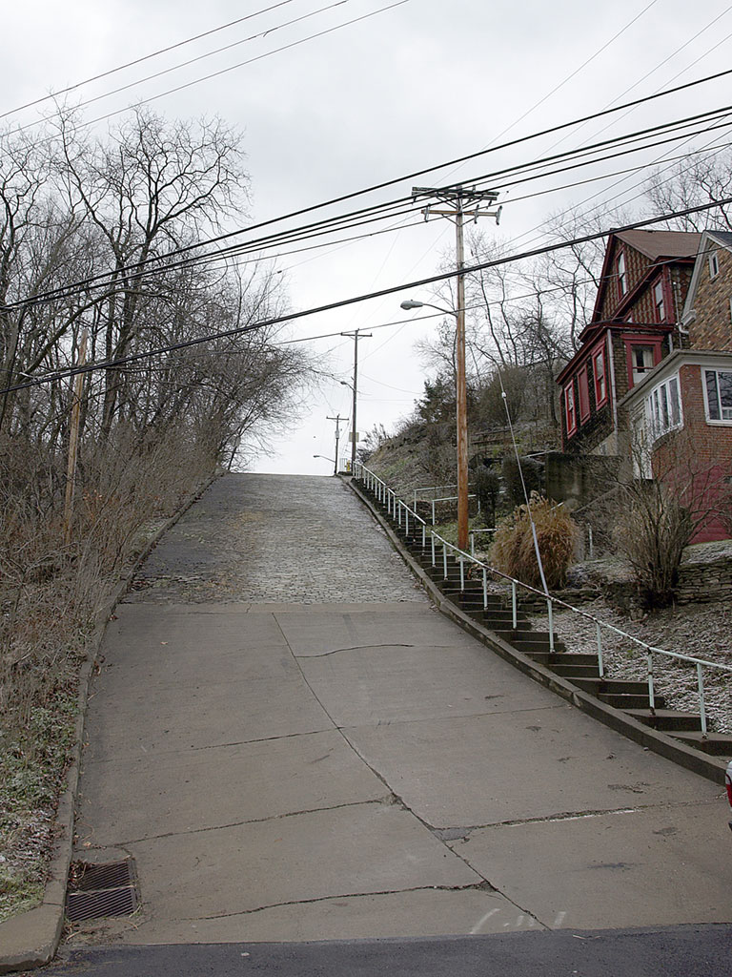
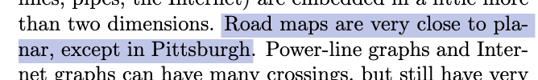
Separator-based graph representation
Canton Avenue
Wikipedia

Slide 6
Prefix codes

Slide 7
The next step:
Dynamic graphs
Experimental verification
Two machines
Different prefix codes
Variants on adjacency-list representation
Lots of graphs:
 | Nodes | Edges
Finite-element meshes | Masses (generally) | Stiffness relationships (e.g. beam)
VLSI circuits | Gates, transistors, etc. | Wires
Map graphs | Cities, intersections, etc. | Roads, paths, streets
Router connectivity | Routers, switches | Links between routers
Link graphs of the web | Web pages, online resources | Hyperlinks

Slide 8
Codes
Adjacency array (38 bits per edge)
Gamma Codes
Nibble Codes
Snip Codes (9 bits per edge)
Byte Codes (12.5 bits per edge)

